Slide 1

Mechatronic engineering Control systems in robotics
proprioceptive sensor velocity data collection
Manuel Alejandro Chalarca Botero
Jose Joaquin Restrepo Palacios

Slide 2

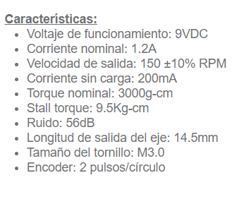
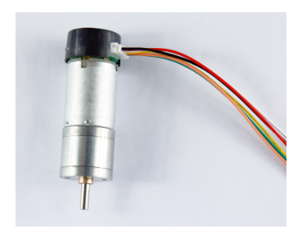
Actuator Requirements
Minimum Pay Load: 200g
Maximum Speed: 80 Rpm
Joint Length: 10cm
Joint weight: 18g
Total weight = 0.2kg+0.018kg =0.218kg
Force = 0.218kg*9,8=2,14N
T = 10cm* 2,14N= 22,43N*cm*105%
T= 2,40 Kgf*cm
T_Stall=9.5kgf*cm
T_Nominal= 3kgf*cm
Cuadrature Encoder 11 PPR
Img 1: Selected Motor.
https://www.didacticaselectronicas.com/images/stories/virtuemart/product/MDC-ENCO-150R-9.5KG_12.jpg

Slide 3

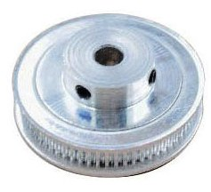
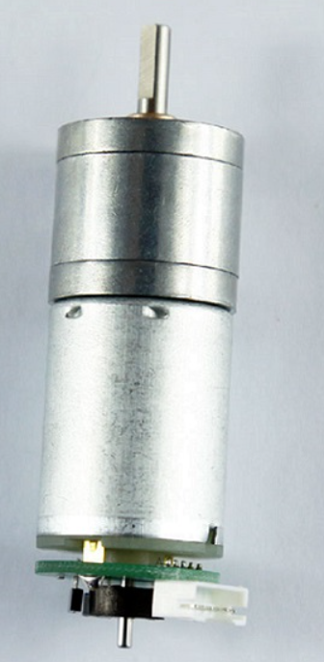
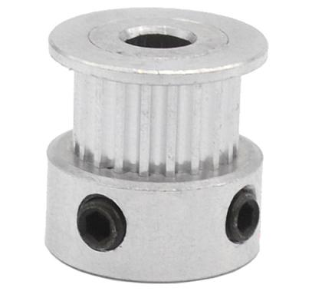
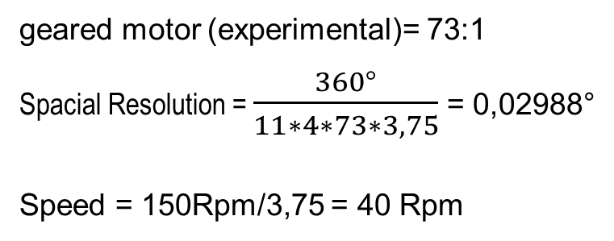
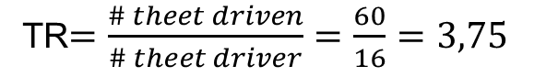
Transmission selection
TR$=\frac{\# theet driven}{\# theet driver}=\frac{60}{16}=3,75$
geared motor (experimental)= 73:1
Spacial Resolution = $\frac{360°}{11∗4∗73∗3,75}$ = 0,02988°
Speed = 150Rpm/3,75 = 40 Rpm
Img2:timing pulley 60 teeth
https://www.didacticaselectronicas.com/images/stories/virtuemart/product/2GT-8-60-5MM_1.jpg
without the pulley we did not reach the required resolution and speed
Img4: Motor whit geared motor
https://didacticaselectronicas.com/~didactic/images/stories/virtuemart/product/MDC-ENCO-150R-9.5KG_2-Motor-encoder.jpg
Img3: timing pulley 16 teeth
https://www.didacticaselectronicas.com/images/stories/virtuemart/product/2GT-8-16-8MM-D3.jpg

Slide 4

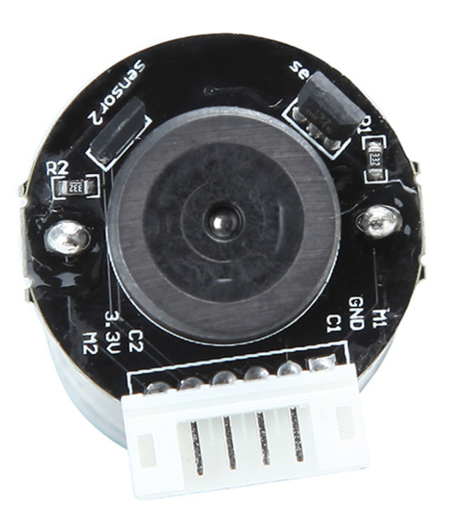
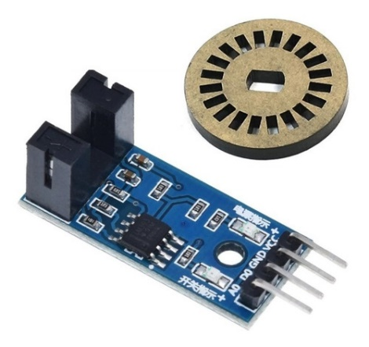
Sensors selection
40 Rpm/60 = 0,67 Rps
0.67 Rps * 3,75 * 73 * 11= 2017,54 Hz (cuadrature encoder)
(horseshoe sensor) 1*0,67 Rps = 0,67 Hz (just for Absolute position)
2017,54 Hz * 4 (signals per magnet) = 8070,152 Hz = 0,12ms
Img_5: Cuadrature Encoder
https://www.didacticaselectronicas.com/images/stories/virtuemart/product/MDC-ENCO-150R-9.5KG-2.png
Img_6: horseshoe sensor
https://http2.mlstatic.com/D_NQ_NP_782101-MCO42616226668_072020-O.jpg

Slide 5

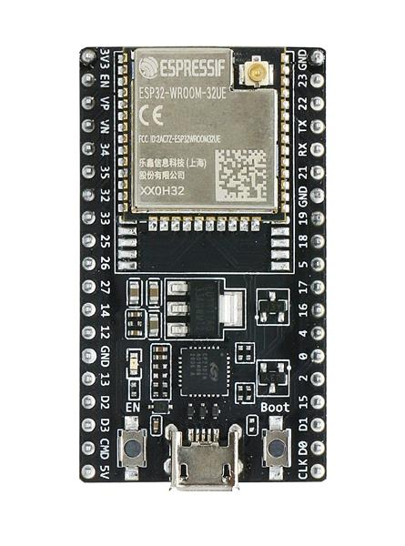
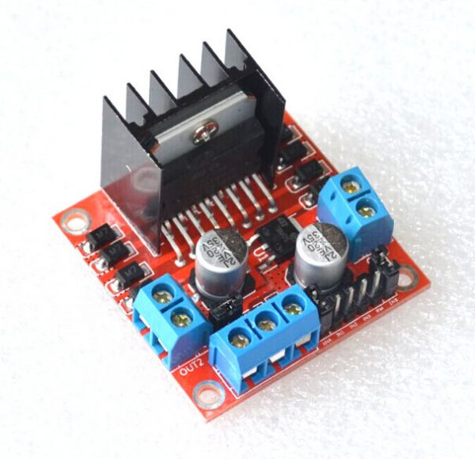
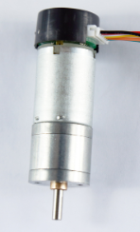
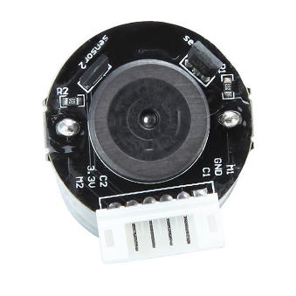
Control design
Ref
Out
Img 7:ESP32
https://co.mouser.com/images/espressifsystems/lrg/ESP32-DevKitC-32UE_SPL.jpg
Img 8:L298
https://http2.mlstatic.com/D_NQ_NP_823266-MCO42069035869_062020-O.webp
Img 1 Motor
Img 5
Encoder

Slide 6
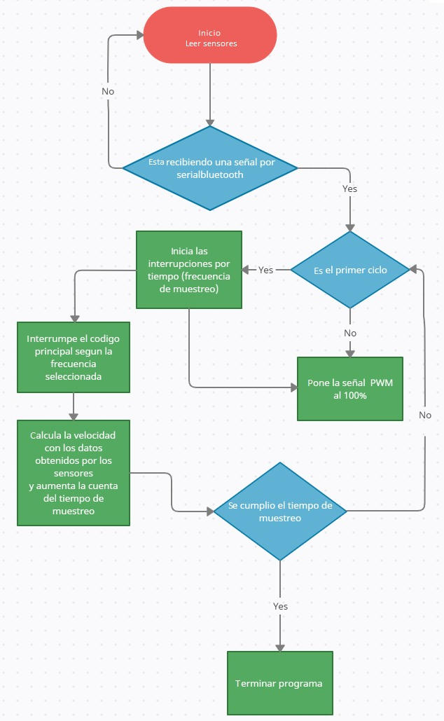
Control Design
Img 9: Flow Char
Own Resource

Slide 7
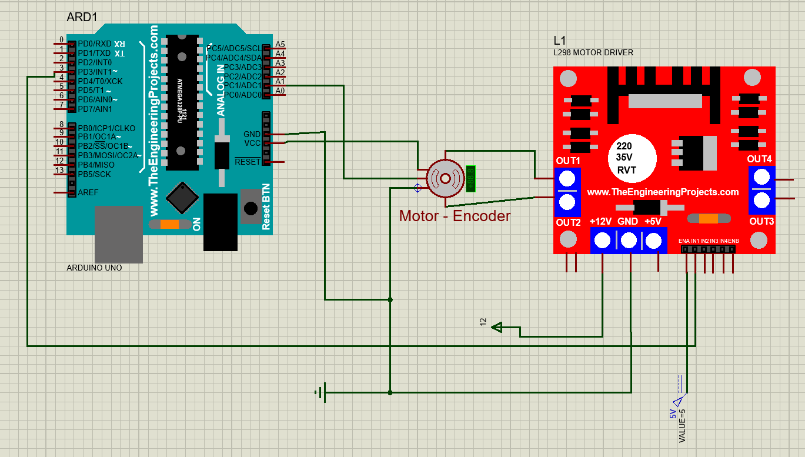
Electronic design
Img 10: Connections
Own Resource

Slide 8
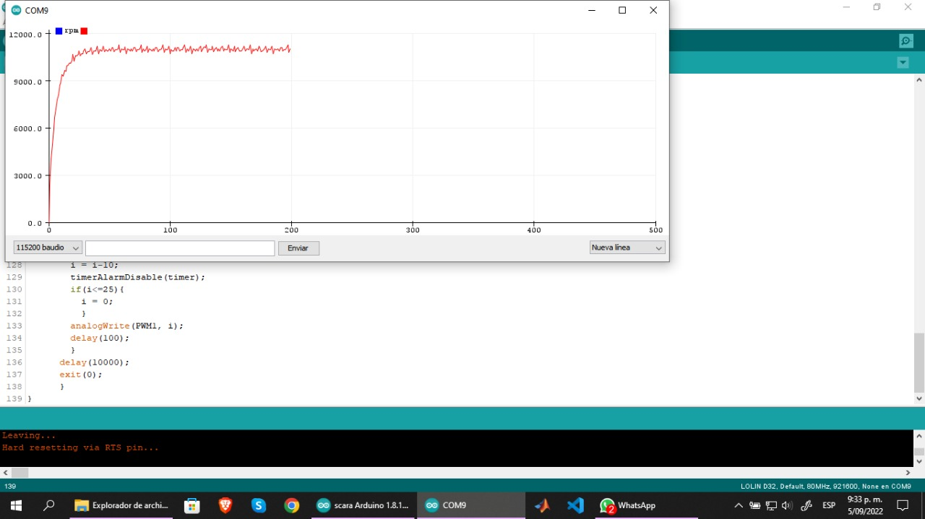
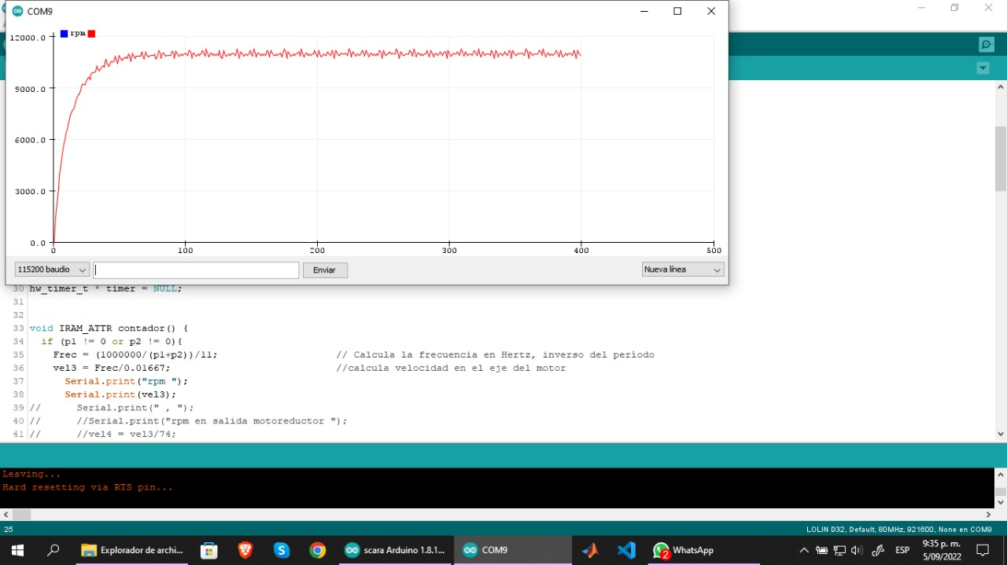
10 ms
Img 11: Speed Graph
Own Resource
5 ms
Img 12: Speed Graph
Own Resource

Slide 9
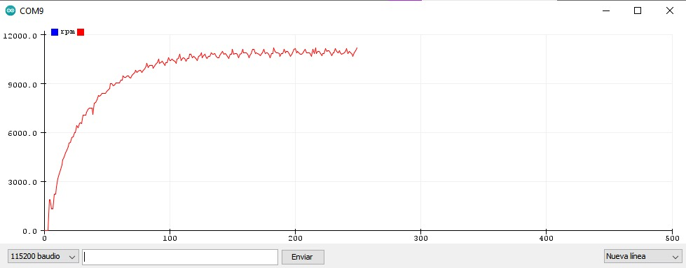
2 ms
Img 13: Speed Graph
Own Resource

Slide 10
References
https://www.vistronica.com/robotica/motores/motorreductores/motorreductor-con-encoder-160-rpm-1-95-kg-cm-1-74-8-detail.html
https://components101.com/modules/l293n-motor-driver-module
https://www.sigmaelectronica.net/producto/esp-32/
https://www.didacticaselectronicas.com/index.php/elementos-electromecanicos/motores-y-solenoides-1/motores-dc-1/con-encoder/motorreductor-con-encoder-150-rpm-9-5kg-cm-gearmotor-de-25mm-para-robot-9vdc-mdc-enco-150r-9-5kg-motores-motorreductores-motoreductores-motor-reductores-dc-con-encoder-150rpm-detail
https://www.didacticaselectronicas.com/index.php/cnc-e-impresoras-3d/sincronismo/poleas-y-engranajes
https://www.didacticaselectronicas.com/index.php/sensores/encoders/encoder-m%C3%B3dulo-optoacoplador-fotointerruptor-sensores-de-velocidad-encoder-fotointerruptores-tac%C3%B3metro-tacometros-detail

Slide 11


